Slide 1


Kiet Video Portal
Project Supervisior: Team :
Dr. Vipin Kumar Monu Ruhela(Leader)
Sumit Gautam
Arya Mishra
Babli Pandey

Slide 2
Introduction
In our project “KIET VIDEO PORTAL” the details of a video sharing website is provided. Through the video sharing process, users can upload, share and also view the videos uploaded by others. Not only this, but also videos can be uploaded online and has different modules. The users do not have authority to delete the records of the website. This authority is given to the administrator only. Users can easily interact to the site as it is easy to use.

Slide 3
Purpose
All users can upload and share videos with their friend.
Users can select the video category at the time of upload.
User can also upload thumbnail.
User can search video via category , video title and keyword.
Administrator or management can manage the users and video.
Admin can accept or reject the video request. Video can published after accepted by admin.

Slide 4
Technologies Used
HTML(Hypertext Markup Language)
CSS(Cascading StyleSheet)
Bootstrap(Library of HTML,CSS and Javascript)
PHP(Hypertext Preprocessor)(Server Side Language)
MYSQL(Database)

Slide 5
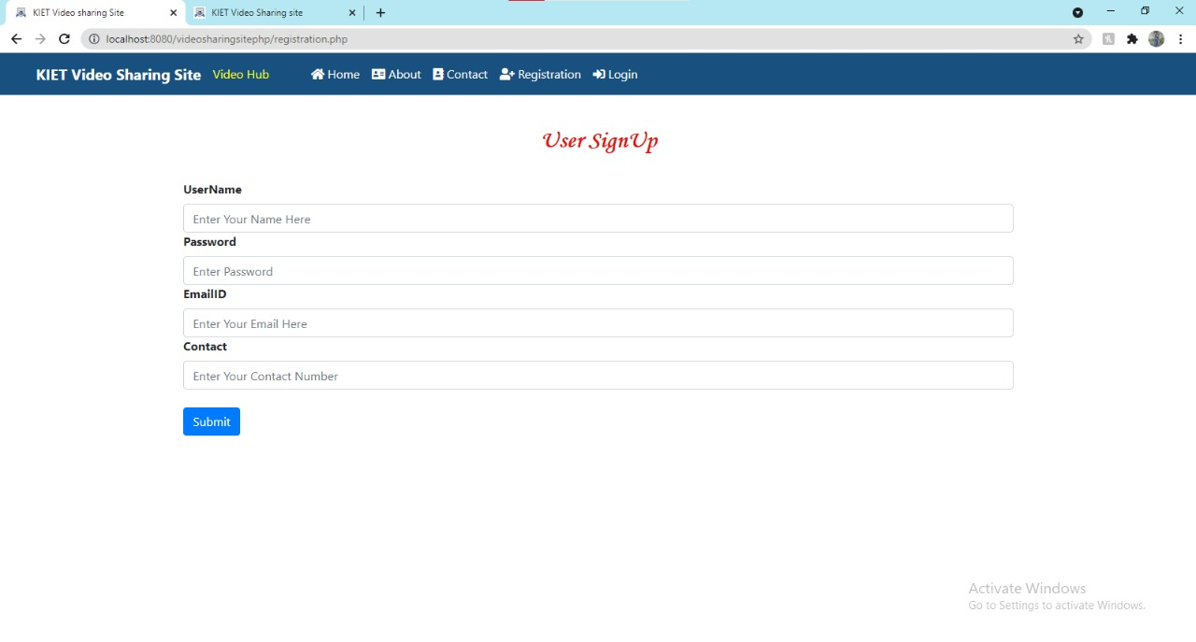
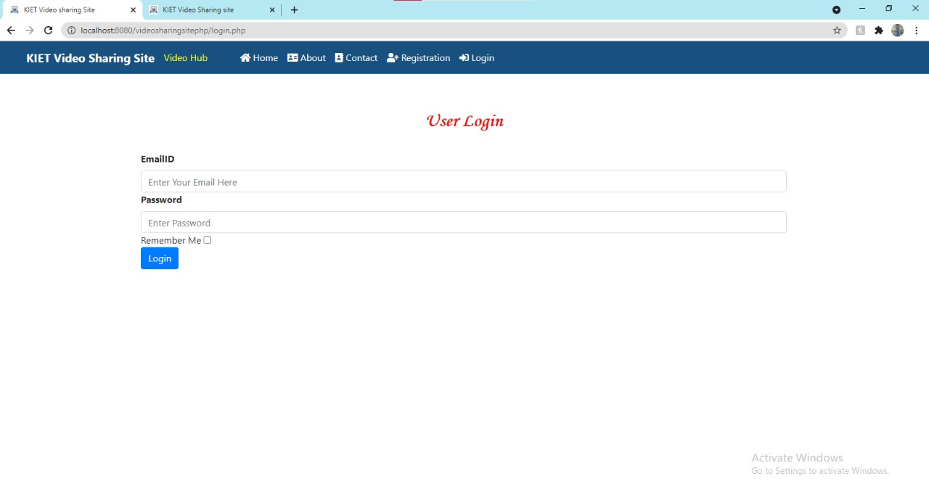
Modules
“User Module”

Slide 6
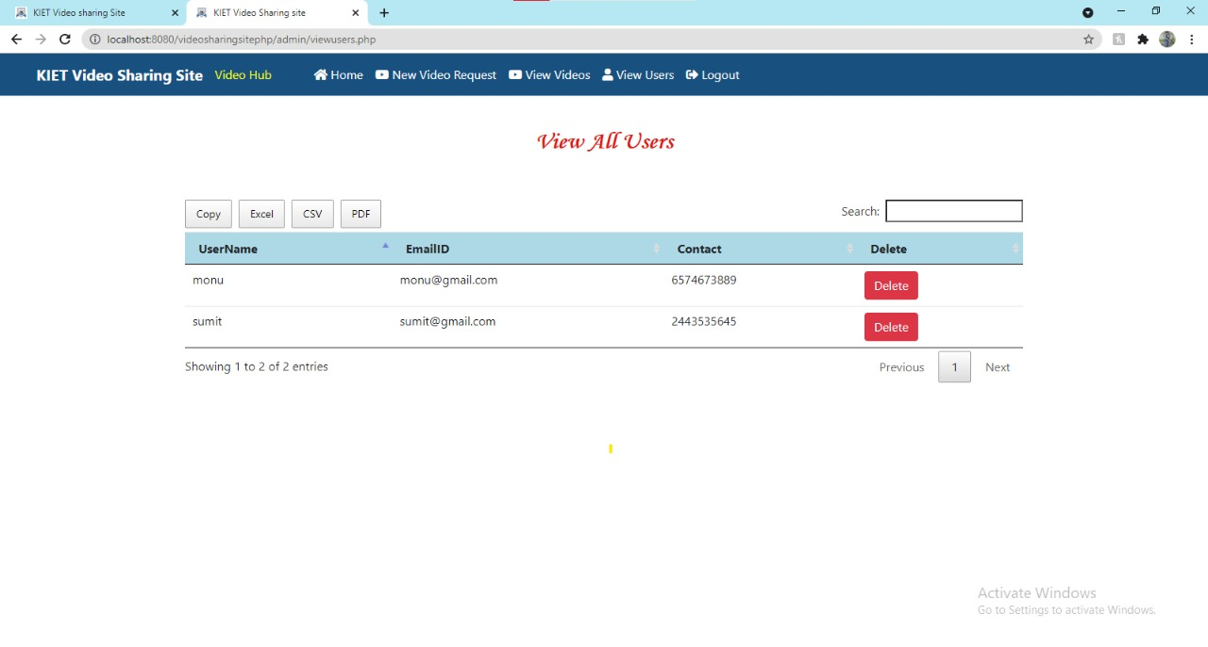
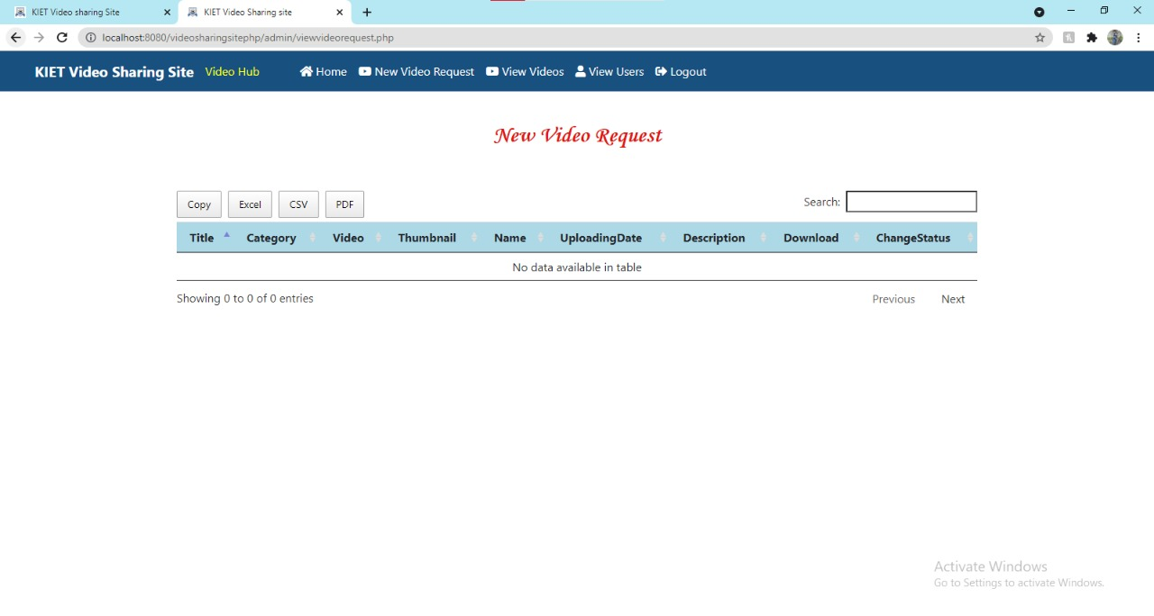
Modules
“Admin Module”

